Slide 1
THE WINGMAN EXPERIENCE
Joseph M. Griffin M.D. , RVT
Vascular Specialty Center
Baton Rouge, LA
Clinical Instructor
Department of Surgery
LSU Health Sciences Center
New Orleans, LA
Clinical Assistant Professor
Department of Surgery
Tulane University
New Orleans, LA

Slide 2
Consulting Agreements
Philips/Volcano

Slide 3
This Wingman Experience ?

Slide 4
How Does The Wingman Fit Into our Clinical Decision Process
Lesion Characteristics
Calcified vs. Non-Calcified Lesions
Vessel Anatomy
Tortuous vs. Non-Tortuous Vessels
Approaches
Antegrade, Contralateral, Pedal Approaches
Devices Sizes
1.4mm vs. 1.8mm vs. 3.5mm Catheter
Support Catheters
Spex vs. Other Catheters

Slide 5
66 y.o male with left foot rest pain and left SFA occlusion on Arterial US with ABI .3
Comorbidities
HTN
Tobacco
ESRD
Contralateral great toe amputation
Attempted contralateral approach but was unsuccessful

Slide 6
Diagnostic from Antegrade Approach

Slide 7
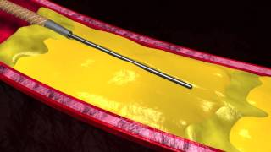
Dorsalis Pedis Approach 1.4 Wingman with SPEX Catheter

Slide 8
Asahi Astato 1.4 Wire

Slide 9
Antegrade Turbohawk Athrectomy with 6 x 120 In-Pact Drug Coated Balloon Angioplasty

Slide 10
55 y.o male with life-stlye limiting claudication of 50 feet who works as an industrial electrician with left SFA occlusion on Arterial US and ABI 0.5
Comorbidites
HTN
DM
No Tobacco

Slide 11
Antegrade Approach

Slide 12
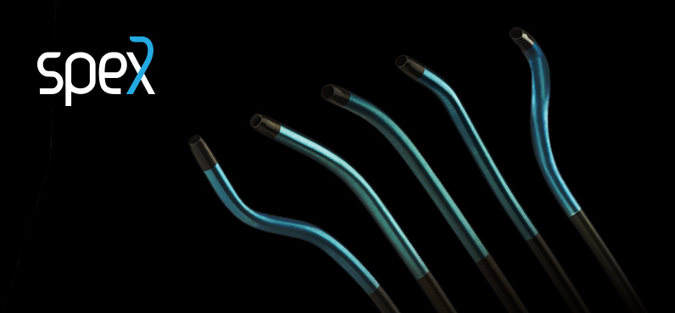
Angled SPEX Catheter with 1.4 Wingman

Slide 16
60 y.o male referred for non healing right foot/ankle wound from the VA clinic with popliteal artery occlusion on Arterial US and ABI .3
Comorbidities
HTN
DM
Tobacco
S/P left AKA due to infected knee replacement
S/P attempted repair of right leg tendon rupture with permanent contracture

Slide 18
Antegrade Approach

Slide 19
3.5 Wingman with .035 Glide Wire

Slide 20
Phoenix 2.2 Athrectomy

Slide 21
4 x 80 mm Drug Coated Balloon (Lutonix)

Slide 23
Hopefully This Will be Your Wingman Experience

